Slide 1
Day 2

Slide 2
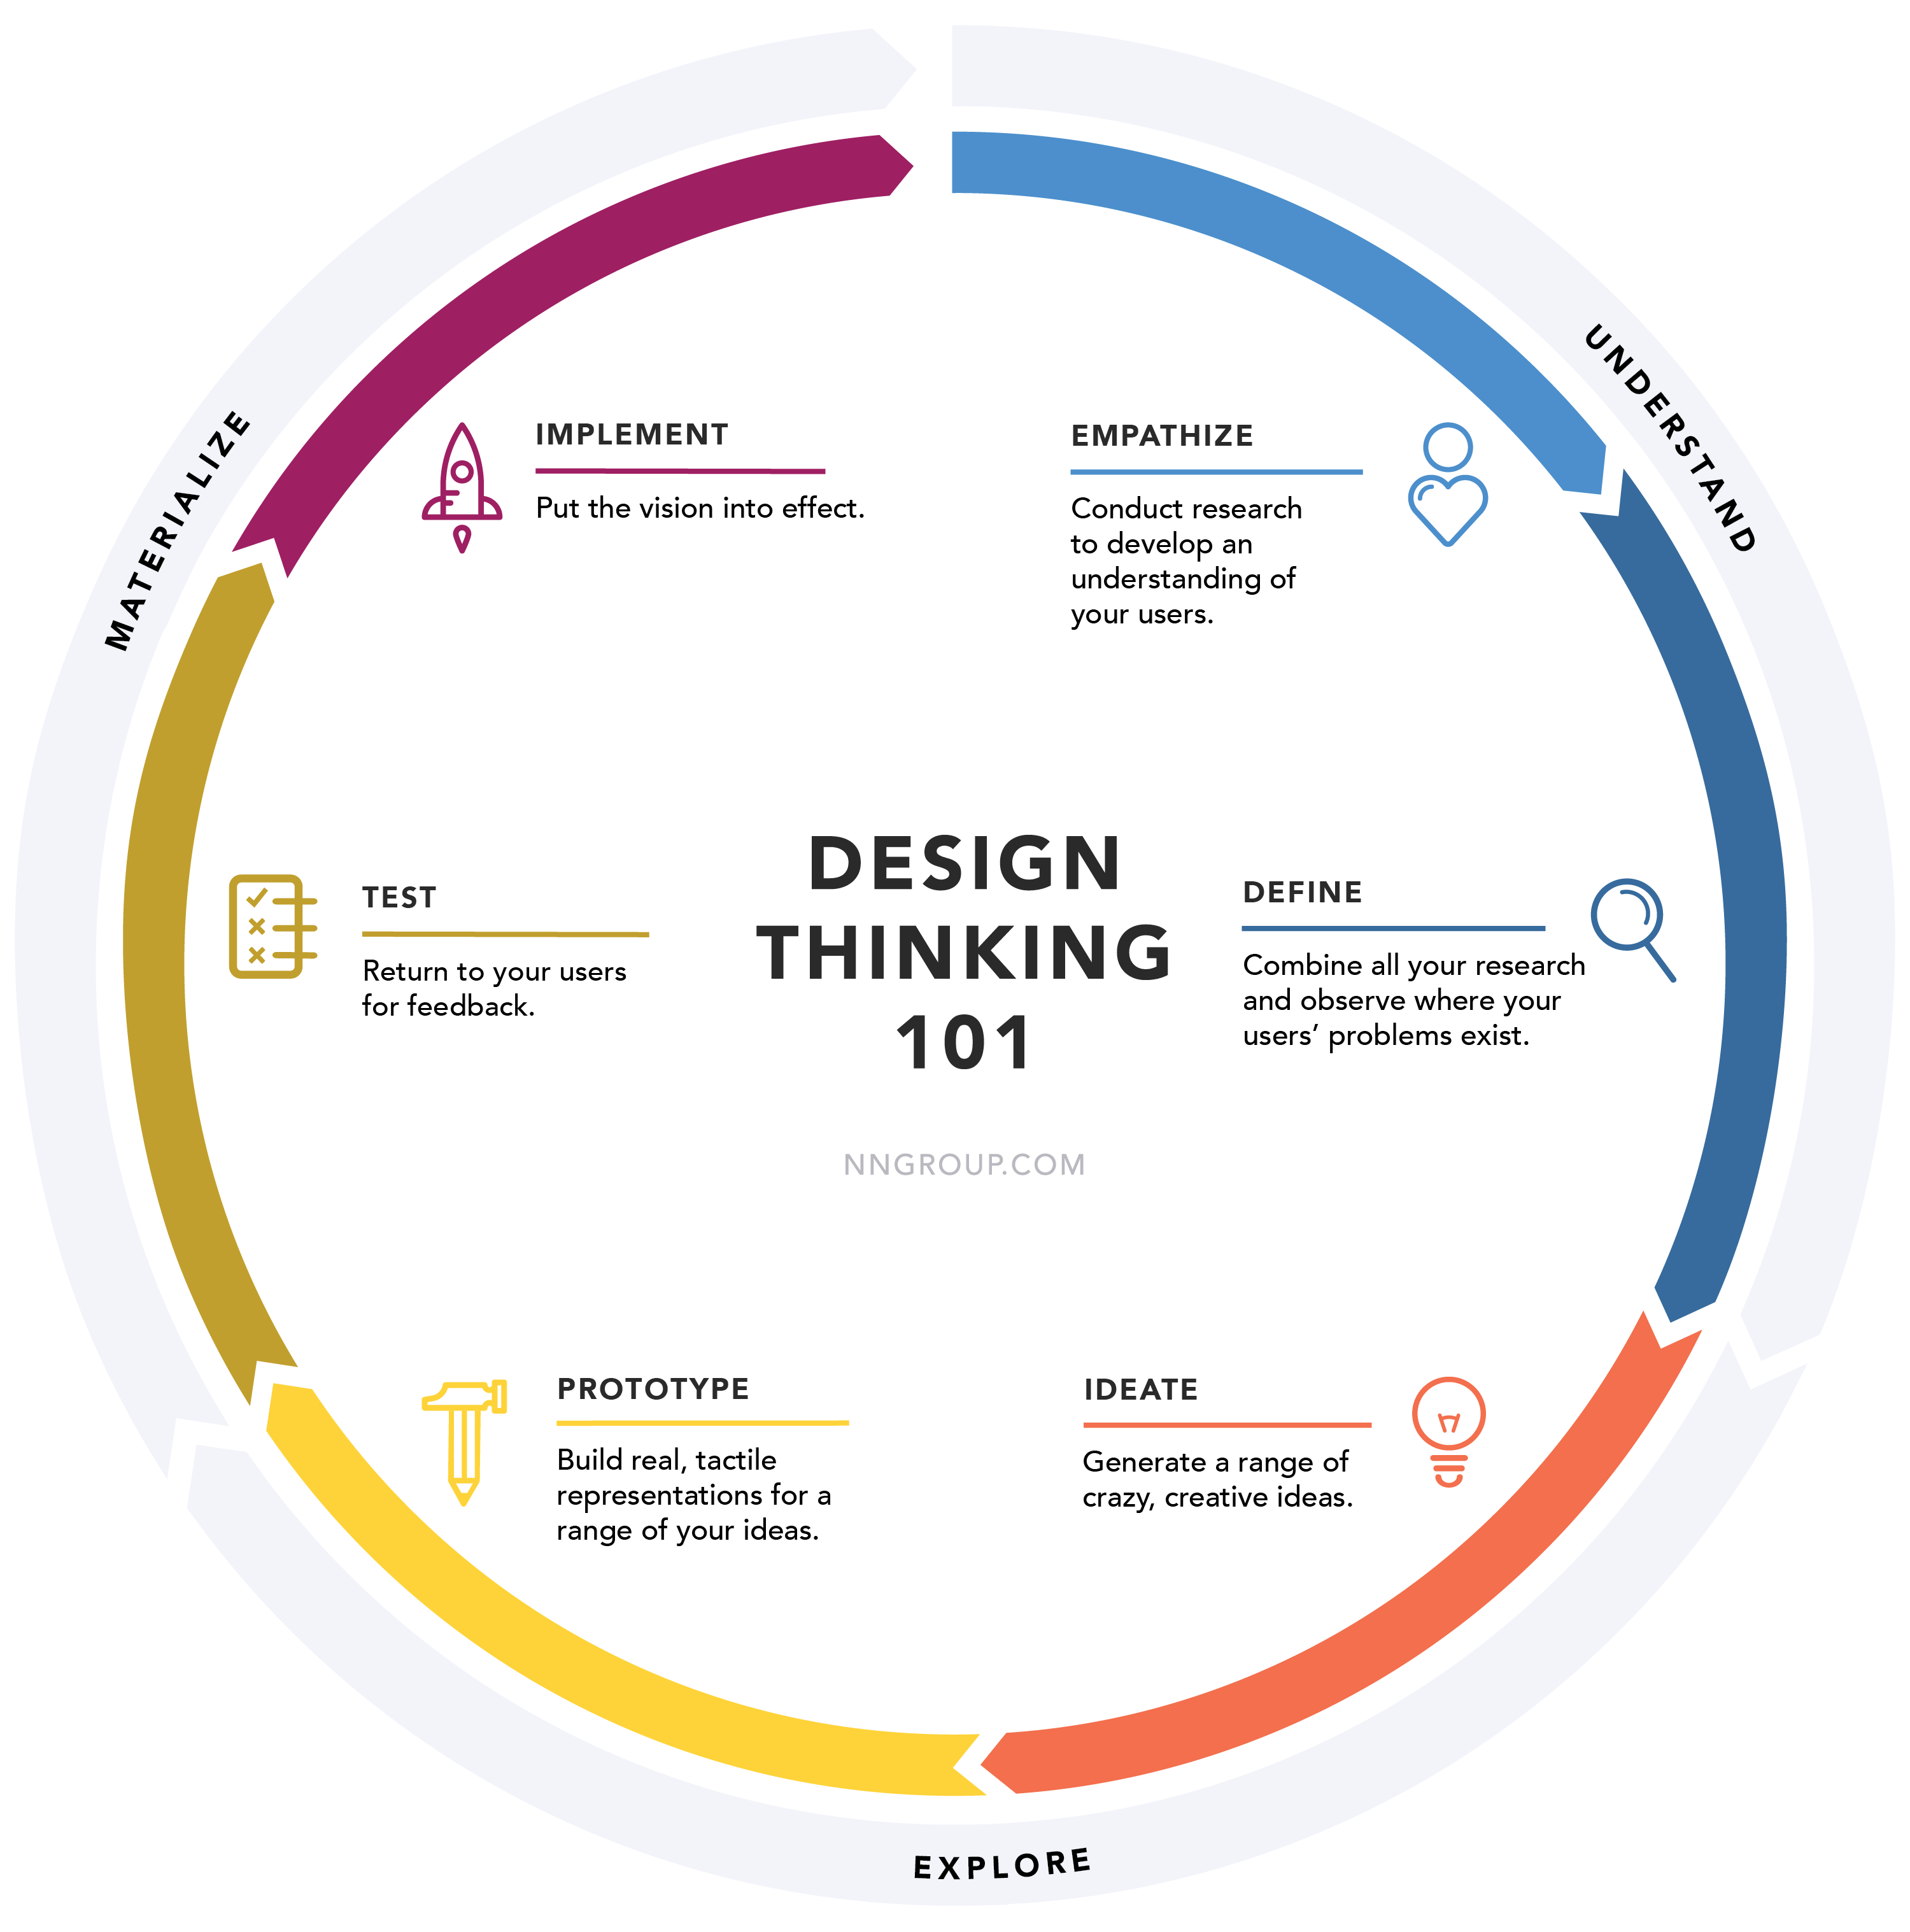
Design Thinking
Design thinking is an iterative, user-centered approach to problem solving.
Core ideas:
Get user feedback early and often
Rapid prototyping
Generate a range of ideas
Avoid locking into bad decisions or design paths
Clearly understand the real problem you are trying to solve.

Slide 3
User-centered design
User-centered design is the idea that, at each phase of the design process, you talk to users and try to understand what their needs are.
First, understand the user context.
What are the problems they care about addressing?
What are their frustrations and pain points?
How do they solve the problem currently?
Ask them to walk through the process.

Slide 4
Evaluate your
solution
against
requirements
Understand
the problem
Gather
requirements
Design
a solution

Slide 5
User-centered design
Need to know your users from all perspectives
Users themselves
Subject matter experts
Other stakeholders – IT, managers, supply chain, their customers
How will you learn what users want?
Interviews
Observations
Surveys
Feature requests

Slide 6
Scenario: managing music
In this exercise, we’ll do some design work to think about how to build a tool to help us manage our music.
User-centered design embeds the user squarely in the center of the design process
It’s an iterative process in which we’re trying to get feedback early and often, so as to avoid heading down dead-ends.

Slide 7
User Requirements
Let’s suppose that we have conducted some surveys and user studies and learned:
Our users want to be able to play their own music easily
They want to be able to create customized playlists
They want to be able to easily share music with their friends.
We’ve also learned the following frustrations they have:
It’s hard to find songs in their collection
It’s hard to keep their music collection organized.
Editing playlists is really cumbersome – they would like more flexibility.

Slide 8
Building a music manager
Based on these needs, we decided on these requirements.
Requirements:
Need to be able to add and delete songs, artists, albums
Need to be able to search by song, album or artist
Need to be able to generate playlists
Need to be able to display all songs on an album, or all songs or albums by an artist.
Need to be able to detect duplicate records.
Load our information from a file and write it back to a file.

Slide 9
Step 1: Aligning requirements with needs
Break into groups.
For each user need, can you see a place in the requirements where we are addressing this need?
Is anything missing?

Slide 10
Lateral Thinking
Sometimes when we are trying to solve a problem, we can get stuck in familiar patterns.
Lateral thinking is a way of coming at a problem or situation from a new perspective, with the hope of spurring new ideas or solutions.
Doing it wrong is a lateral thinking exercise.

Slide 11
Doing it Wrong
In this exercise, we’ll try to come up with as many ways as possible to build a bad music manager.
Not just broken, but frustrating, confusing, difficult to use.
You may have some real-world examples to draw upon!
Sometimes, this will expose requirements we forgot about.

Slide 12
Step 2: Building our API
One part of our music library is an API.
A set of classes and interfaces that will allow other programs to use our Library.
How can we do it wrong so as to make it:
Difficult to use
Hard to maintain
Inefficient
Confusing
Introduce subtle bugs

Slide 13
Step 3: Frustrating our users
We’ve heard that our users really want two things:
Simplicity – they don’t like complicated UIs, reading documentation, or having to fiddle around with settings.
Customization. They want to be able to create their own playlists, get recommendations, and personalize their experience.
How can we build the UI wrong? What are some design choices that would maximize frustration?

Slide 14
Step 4: Frustrating ourselves
We know that we’re going to be working on the project for at least a year, with several versions being released and multiple independent teams.
What can we do to make sure this is a frustrating experience?

Slide 15
Risk Identification
For each of the four areas, examine your problems, choose the most interesting ones, and ask:
Why is it a problem?
What are potential bugs or errors?
How serious is the problem?
Order/group your solutions by seriousness

Slide 16
Idea Reversal
For each of your “bad” solutions, how might you turn them into “good” solutions?
Are there principles that we’ve learned in class that you might apply?
By “inverting” the problem, can you find an interesting solution or approach?
Are you reminded of issues you might have glossed over?

Slide 17
Return to yesterday
Now that we know a little bit about design thinking, dig up the idea that you started thinking about yesterday.
Who are your users?
How would you get feedback from them?
What is the/a core problem that you want to address? Can you state it clearly and succinctly?
How might you construct a proof of concept to help you understand the problem better?

Slide 18
Break

Slide 19
Programmatic interfaces for LLMs
Yesterday we saw how to use an LLM as a tool for generating code, and how to use it within the browser to brainstorm.
We can also use an LLM as a service within our programs.
Call out to get results of prompts.

Slide 20
Models and ecosystems
When using an LLM as a service, we often talk about the different models that are available.
There’s a lot!
Different companies
Different sizes
Different licenses
Different training regimens
Different capabilities
Different inputs

Slide 21
Hugging Face
Hugging Face is an open platform for hosting AI models, datasets, tutorials, and more.
You can run code there, host your own models, find fully-baked applications, and more.
Tons of great resources.
https://huggingface.co/

Slide 22
Model Cards
A model card is a standardized way of describing a deep learning model.
How was it trained?
What’s its size?
What are the license requirements?
What are its capabilities?
How can you access the model?

Slide 23
Examples
The actual usage is pretty straightforward:
client = genai.Client(vertexai=True, project=PROJECT_ID, location=LOCATION)
response = client.models.generate_content(
model=MODEL_ID, contents="What's the largest planet in our solar system?")
display(Markdown(response.text))
Contents is the string sent to the LLM, and the result is in response.

Slide 24
Lab – using Vertex AI Studio
In this lab, you’ll work with Google’s Vertex AI studio to see some examples of how to programmatically interface with AI models.
Fussiness level increasing – there’s a little tinkering needed to get everything working correctly.
Google account
Vertex API key
Project ID
Think about how you might use this capability in your own project.

Slide 25
Lunch

Slide 26
Multimodal AI
As we saw in the lab before lunch, Vertex AI can work with other inputs besides text.
Images
Sound
Video
Rich document formats

Slide 27
Processing images with neural nets
So how can we process images with this approach?
How do computers represent images?
How can AI tools generate realistic images?
Why do they have a hard time with fingers?

Slide 28

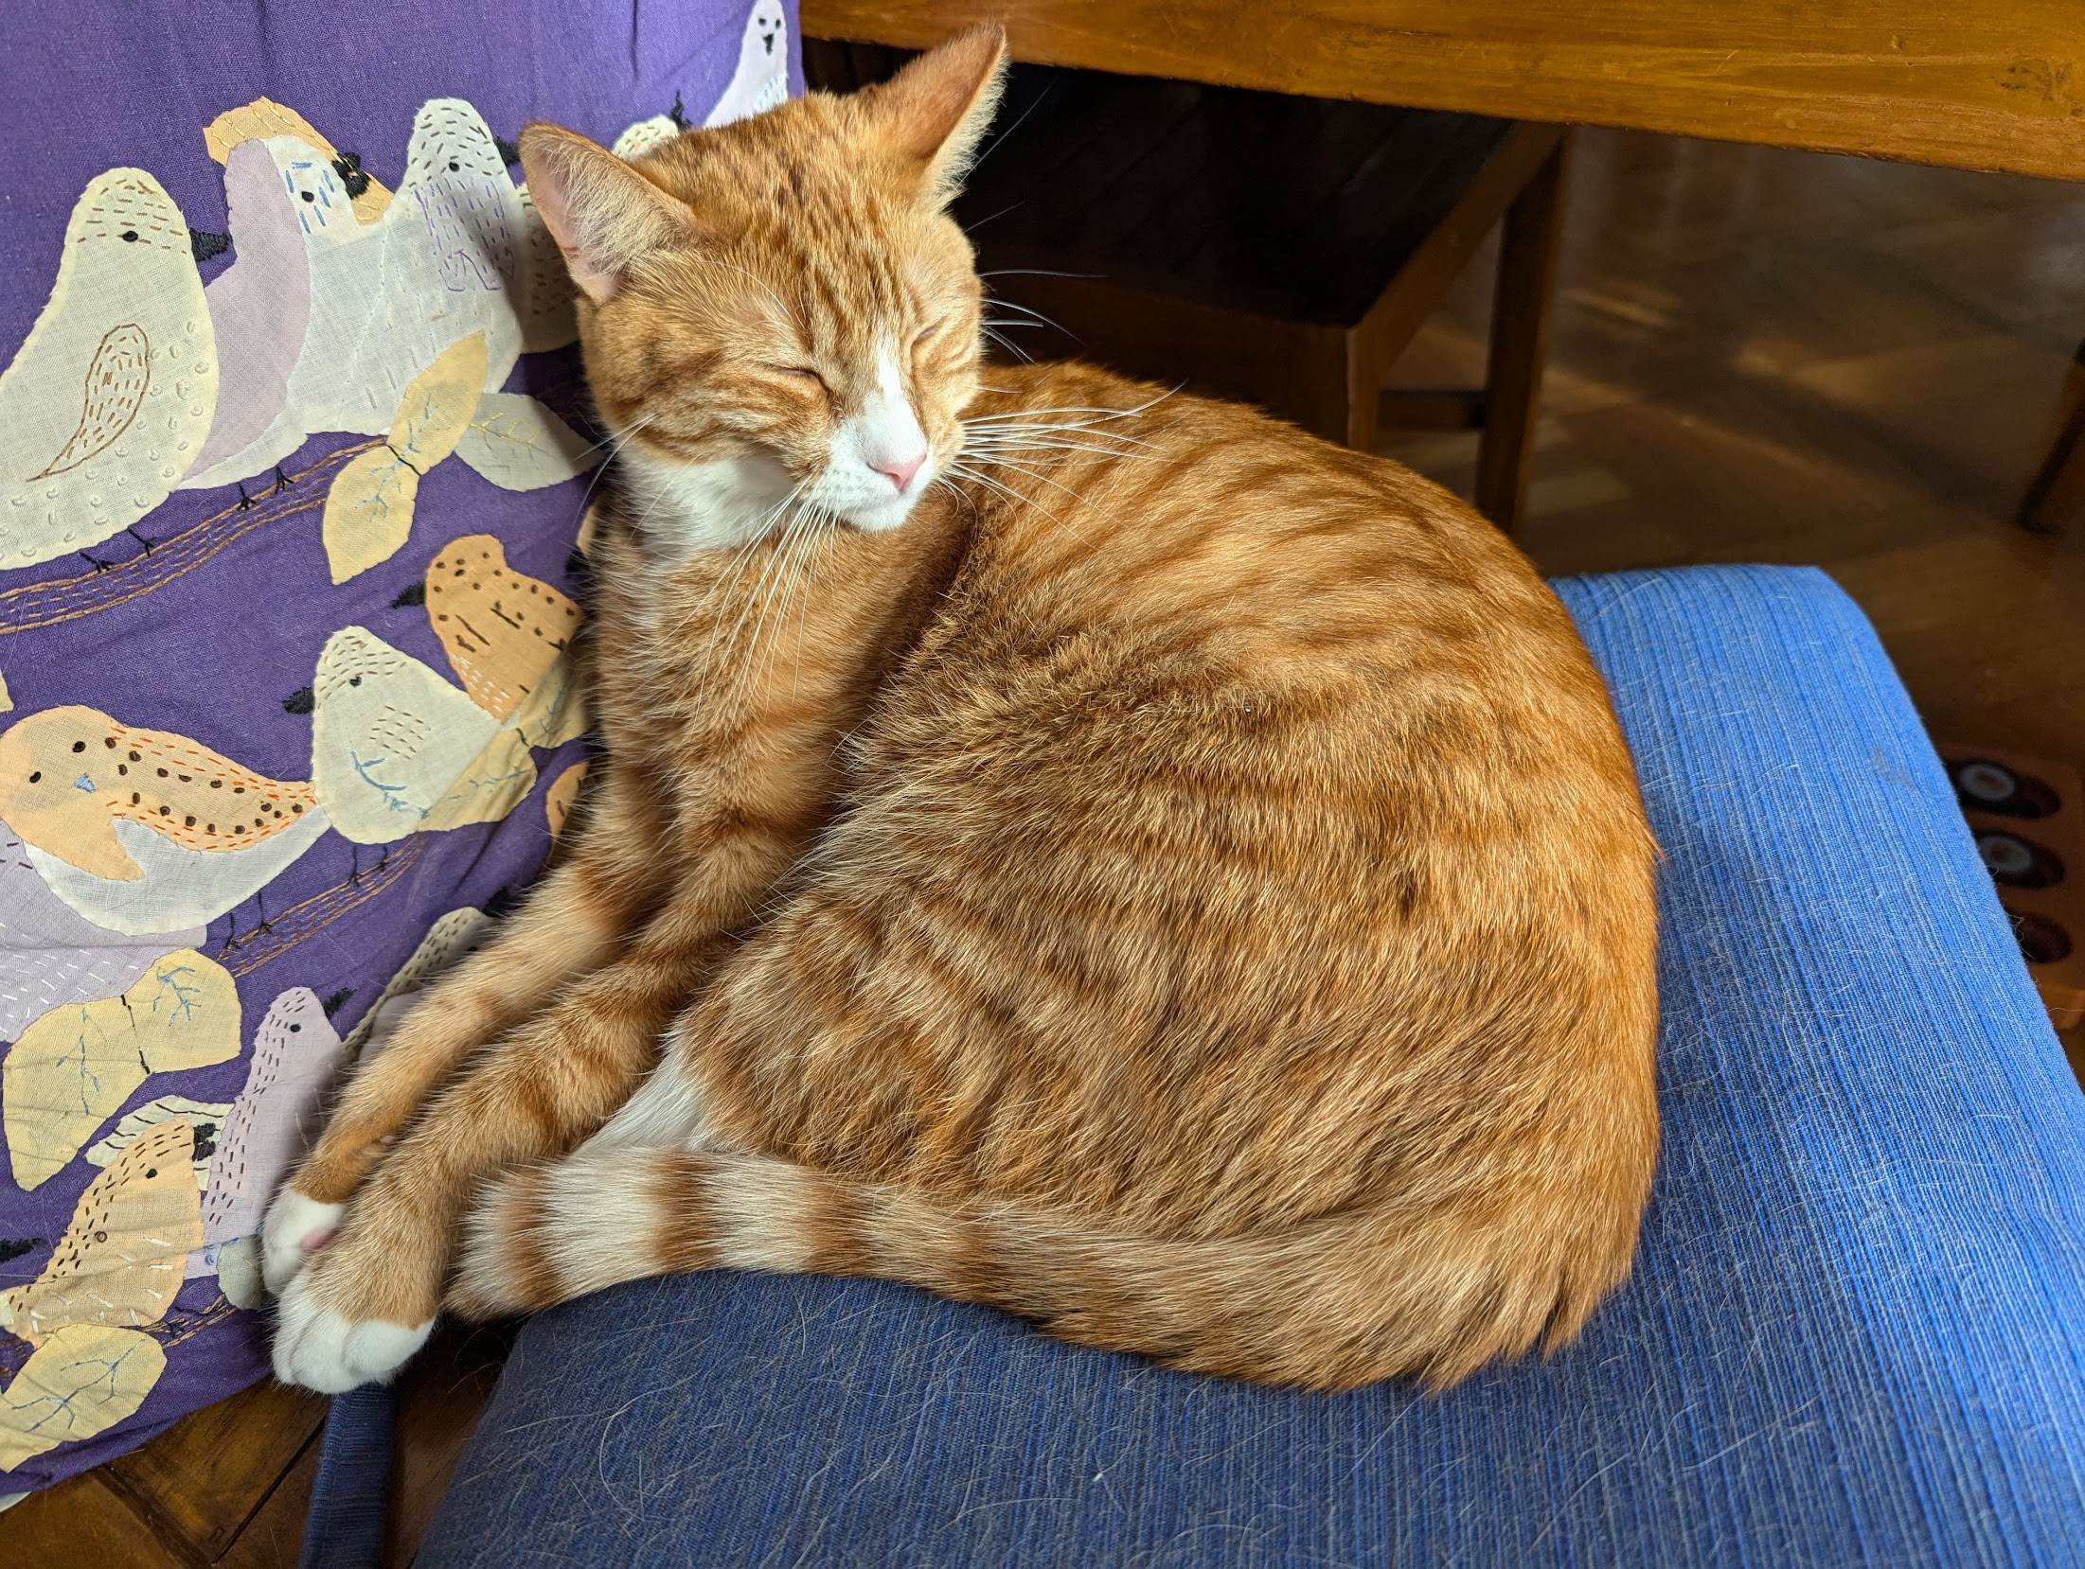
Reminder: pixels
Images are comprised of a large number of pixels.
A pixel can be thought of as a set of numbers <x,y,z> representing the color at that point.
<x,y,z> are usually the red, green, and blue in that color.
(sometimes we have other color scales, or other values such as luminance)
That means that we can think of a picture as an array of features, each of which is a pixel.

Slide 29
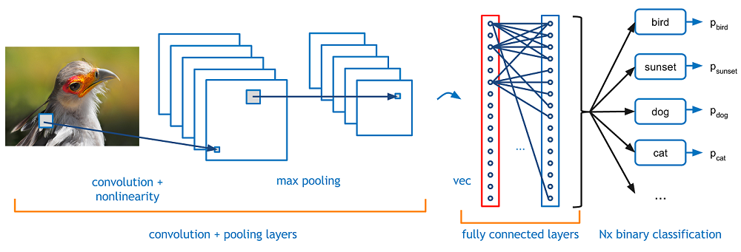
Classifying images
Classifying an image is the task of mapping a label to an image.
We start with labeled training data, and use this to detect patterns.
https://huggingface.co/datasets/imagenet-1k

Slide 30
Classifying images
We embed the image into a smaller space that’s easier to work with.
We then train the network to associate particular embeddings with particular labels.

Slide 31

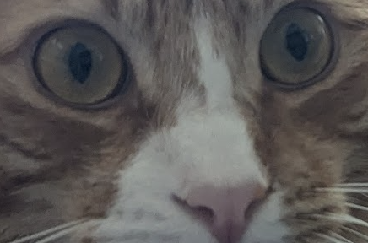
Classifying images
What is being learned?
Low-level relationships between pixels
Are composed into higher-level features
And then relationships between these features are induced.
Note: We have redefined the problem from
”is that a cat” to “does this collection of pixels meet a threshold.”
Pictures with this set of relationships between features are placed into the class “Obi-wan”.
No symbols being used!

Slide 32
Image Foundation Models
As with text, we can create a foundation model for images.
Take a huge collection of images and learn relationships between pixels, then between higher-level features.
A foundation model can then be easily fine-tuned to classify particular types of objects, such as cats or illegal gold mines.

Slide 33
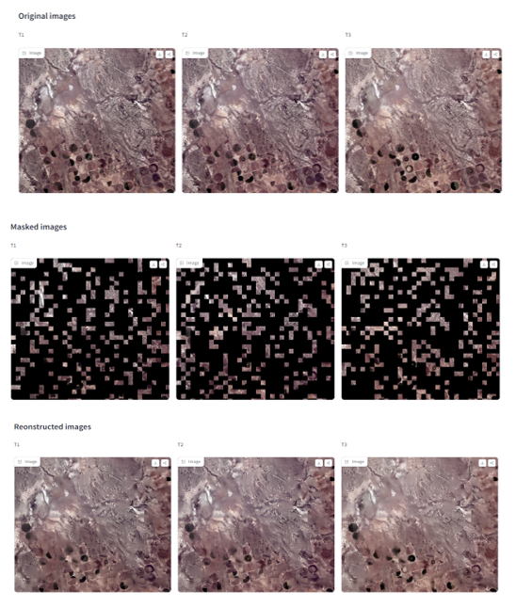
Vision Transformers
Prithvi is a vision transformer.
It operates on geospatial data.
It’s initially trained using masked input.
It can then:
Reconstruct images from partial input
Detect changes over time
Act in an unsupervised way to perform image similarity
Fine-tune to act as a classifier.
Detect features, count elements.

Slide 34
Graph Neural Networks
With some care, we can also encode a graph as a neural network.
Our input vectors are the nodes, adjacency list, and some additional connectivity information.
Our layers are then graph convolutions that are ensured to produce new valid graphs.
We can then use this to build graph foundation models.
For example:
https://research.google/blog/insights-into-population-dynamics-a-foundation-model-for-geospatial-inference/

Slide 35
Bias in image classification
This approach is extremely effective at finding patterns in what it is given.
It does not have knowledge of the context around it.
If our training set contains biases, these biases will be learned by the classifier.
For example, underrepresentation of dark-skinned faces in a facial recognition app.
Prejudicial or societal biases become inductive biases!

Slide 36
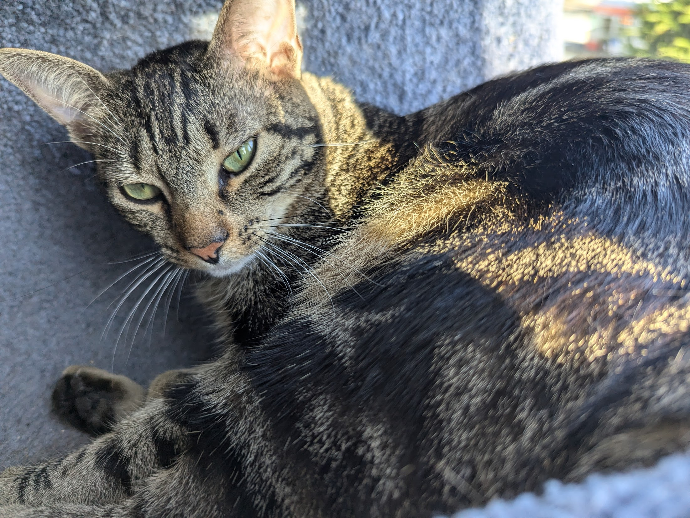
What about image generation?
Classifier
”Obi-Wan”
What if we took our image classifier …

Slide 37
Image generation
Generator
”Obi-Wan”
And ran it in reverse?
Then, for different classes of cats, we could make cat pictures!

Slide 38

Image generation
LLM
generator
”Orange fluffy cat”
embedding

Slide 39
Explaining the weird fingers
The whole trick to this is to connect the embedding spaces.
Map the prompt to a point in a smaller space.
Map that onto a point in the embedded space of pictures
Create a small picture from this.
Use ‘upsampling’ to make the picture larger and fill in details.
If this pixel is red, what are the most likely colors for its neighbors?
What tends to go next to a finger? Another finger!

Slide 40
Embeddings: one big idea
Deep learning systems don’t work with text or images directly.
Too informationally dense.
Embeddings allow different tools to connect to each other.
By cleverly connecting embeddings, we can create tools that use multiple modalities.
Connecting text to vision or sound.

Slide 41
Embeddings
Most of our inputs have several problems:
They are far too large (or informationally dense)
There’s too much noise and extra detail
Our features are ambiguous (‘fly’ might mean an insect or an action)

Slide 42
Embeddings
Once we can represent our inputs as vectors, we can use linear algebra to map them into new spaces with preferable characteristics.
Smaller, linearly independent bases, “similar” datapoints located close to each other.

Slide 43
Latent Semantic Analysis
https://upload.wikimedia.org/wikipedia/commons/transcoded/7/70/Topic_model_scheme.webm/Topic_model_scheme.webm.480p.vp9.webm#t=00:00:01,00:00:17.600
LSA decomposes the larger document-term matrix into smaller submatrices of lower rank.
Separates out the bases.

Slide 44
Learning embeddings
LSA is great for correlation, but doesn’t reduce dimensionality.
A more modern approach is to learn embeddings as a supervised learning task.
Word2vec is the most well-known tool that has done this.

Slide 45
Embeddings lab

Slide 46
Break

Slide 47
Project discussion
Now is time for you to:
Talk with your peers/friends/teammates about how you might use what we’ve learned on your project.
Get feedback/ask questions
Build!!
We’ll check in at the end of the day and see where people are at.

